Slide 1


Decentralization and Consensus Algorithms
The Meaning of Decentralization Proof-of-Work, Proof-of-Stake, Network Forks
Sevgin Mustafov
Blockchain Developer & Course Developer
Academy School of Blockchain
http://kingsland.academy

Slide 2





Table of Contents
The Meaning of Decentralization
What is Consensus Algorithm?
Proof of Work (PoW)
Proof of Stake (PoS)
Proof of … (whatever)
Cryptocurrencies and Consensus
Network Forks: Hard Forks and Soft Fork

Slide 3
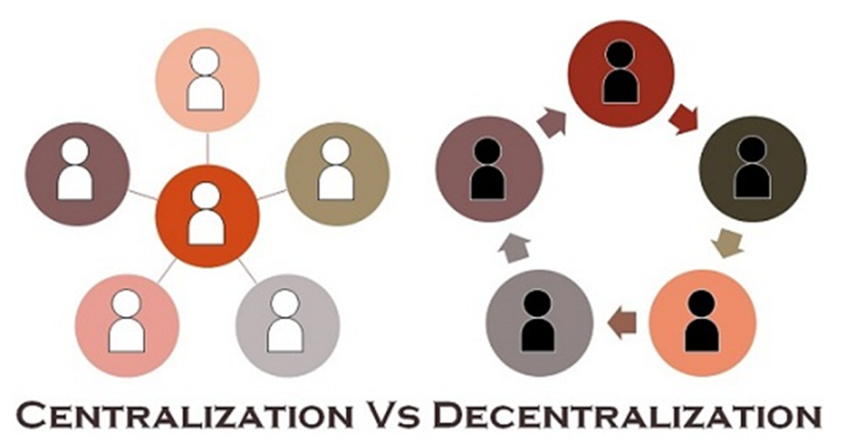
The Meaning of Decentralization

Slide 4
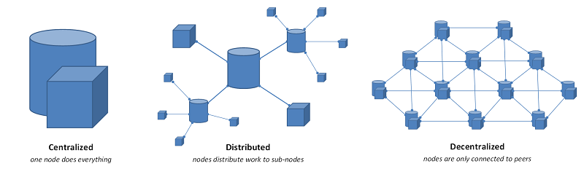
Centralized, Distributed and Decentralized
Centralized
A single (central) unit of processing
Distributed
Pieces of transaction processing are done in different places
Distributed processors are under the control of a single entity
Decentralized
Not one single entity has control over all the processing

Slide 5
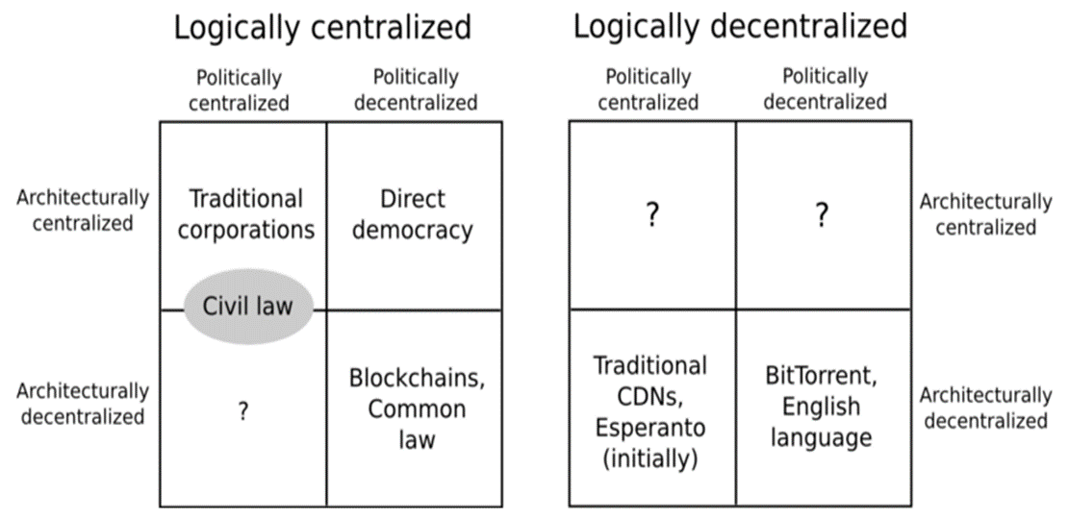
Three Types of Decentralization
Architectural (de)centralization
Political (de)centralization
Logical (de)centralization

Slide 6









Three Reasons for Decentralization
Collusion resistance
Data stored cannot be manipulated
Much harder to collude and to act in fraudulent way
Fault tolerance
Less likely to fail accidentally
Attack resistance
More expensive to attack

Slide 7
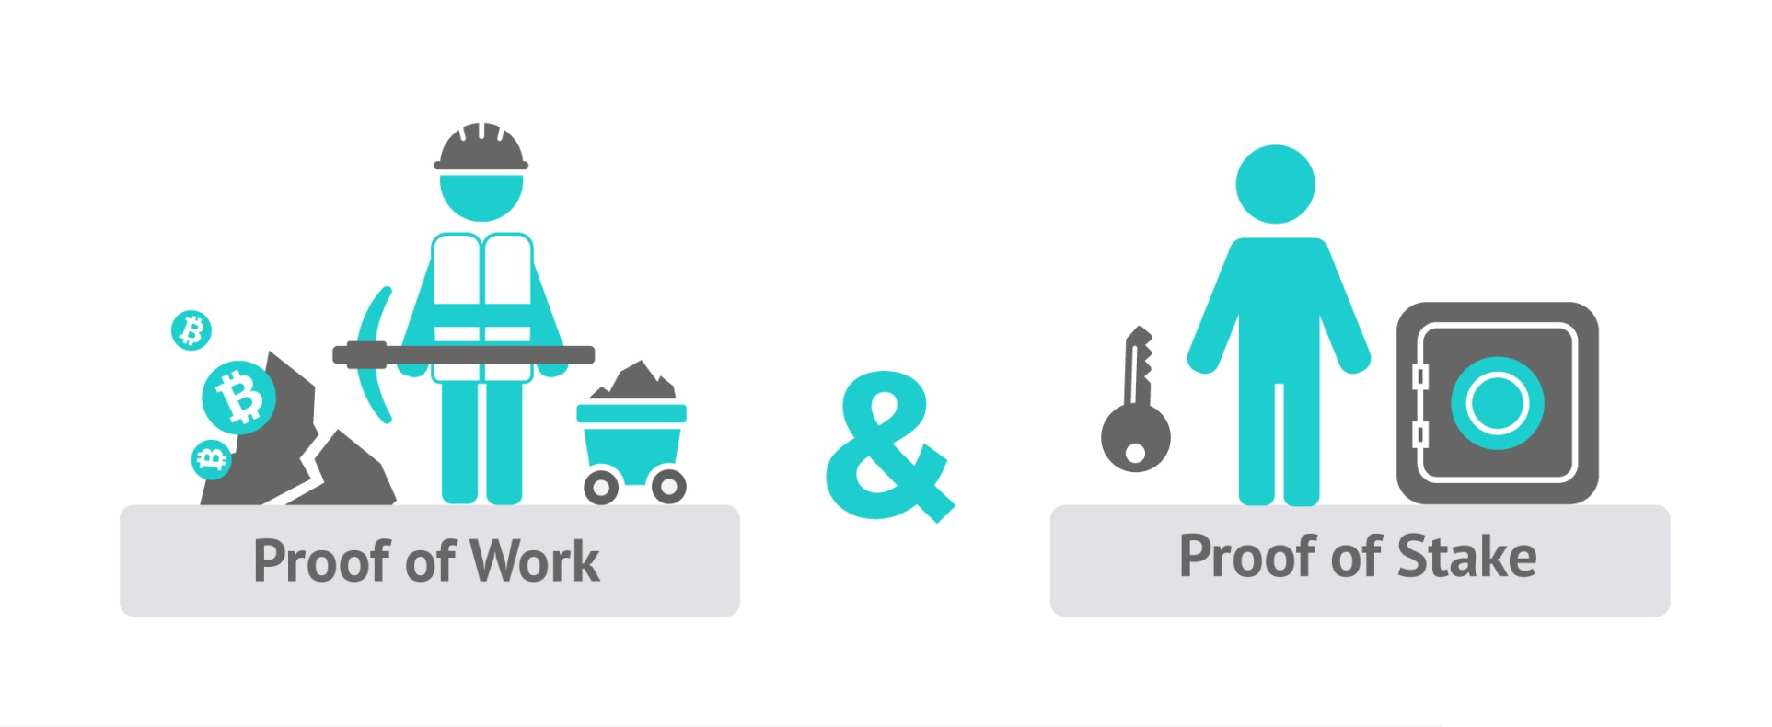
Consensus Algorithms
Proof of Work, Proof of Stake, Proof of Burn, etc.

Slide 8

What is Consensus Algorithm?
Consensus algorithm (consensus protocol / consensus mechanism)
Algorithm to reach agreement among the blockchain nodes
All nodes should agree about the changes in the distributed ledger
Proof-of-work (PoW), Proof-of-stake (PoS), other algorithms

Slide 9
Consensus Algorithm – Requirements
Fault-tolerance
Some nodes will be unavailable when the ledger is changed
Consensus should be reached by part of the nodes (e.g. majority)
Attack-resistance
Some nodes will intentionally behave incorrectly
Honest nodes should win in the consensus process
Everyone on the network can verify the next block's correctness
Too much resources should be required for a successful attack

Slide 10
Proof-of-Work (PoW)
A "proof-of-work" (PoW) is a piece of data which is:
Difficult to produce
Easy for others to verify
Producing a proof-of-work can be a random guessing process
Or can be organized in mining pools (joint PoW production)
Example:
Find a number x, such that SHA256(text + x) has 10 leading zeroes
10 zeroes == network difficulty

Slide 11

Proof-of-Work: Problems
Needs computing power
Computationally expensive
Energy intensive
51% attack
Attackers holding more than 50% of the power could potentially reverse-back transactions (double-spend money) / deny service
Hashing algorithm types for PoW consensus
ASIC mineable (e.g. SHA256), CPU mineable (e.g. CryptoNight), GPU mineable (e.g. ETHash), CPU + GPU mineable (e.g. Equihash)

Slide 12

Proof-of-Work: Problems (2)
Transactions speed – average wait time
Bitcoin: new block mined in ~ 9-10 minutes
Ethereum: new block mined in ~ 10-15 seconds
Business needs real-time transactions (milliseconds)
Transactions throughput – transactions per second (tps)
Bitcoin: 2000-3000 / transactions per block → 3-5 tps (up to 7 tps)
Ethereum: 200-300 / transactions per block → 10-15 tps
Business needs thousands tps (e.g. VISA performs 2000 tps)

Slide 13
Proof-of-Work Cryptocurrencies
Different cryptocurrencies use different hashing algorithms
Bitcoin, Bitcoin Cash – SHA256 – ASIC mineable
Ethereum, Ethereum Classic – ETHash – GPU mineable
ZCash, Bitcoin Gold – Equihash – CPU and GPU mineable
Monero – CryptoNight – CPU and GPU mineable
Litecoin, Dogecoin – SCrypt – GPU mineable
Dash – X11 – ASIC, CPU and GPU mineable
Stratis – X13 – ASIC, CPU and GPU mineable
See bitinfocharts.com

Slide 14

Proof of Capacity (PoC)
Similar to PoW, but based on HDD, not CPU / GPU
Pay for mining with hard drive space
More hard drive space → better chance of mining the next block
Calculating hashes is slow, so hashes are stored in the HDD for faster access
Plots – large data files holding of precomputed hashes
More plots → better your chance of finding the next block
Plot size is similar to hash rate in PoW
burst-coin.org

Slide 15
Proof of Stake (PoS)
PoS is designed to increase network security and reduce resource wasting
The creator of the next block is chosen in
Combinations of random selection and wealth
E.g. holding 1% of the coins gives the chance to verify (mine) 1% of the "Proof of Stake blocks“
The "Monopoly Problem": a monopolist (holder of the most coins) could double spend or deny / filter other's transactions
Executing a monopoly attack is much more expensive than in PoW

Slide 16
From PoW to PoS Consensus
Proof-of-stake (PoS) blockchains either
Start from a PoW algorithm to mine initial amounts of currency
Then switch to proof-of-stake, relying on the mined stakes
Example: BitConnect (bitconnect.co)
Or fork existing PoW blockchain with all its transactions, then switch to PoS-based consensus
Example: PIVX (pivx.org) forked from Dash
Or run a hybrid PoW + PoS consensus mechanism

Slide 17






Popular PoS Cryptocurrencies
Peercoin - peercoin.net
Cardano – cardanohub.org
Qtum – qtum.org
PIVX – pivx.org
BitConnect – bitconnect.co
Stratis – stratisplatform.com

Slide 18
Delegated Proof of Stake (DPoS)
Stakeholders vote for delegates in democratic way
Every wallet holding coins can vote for delegates
Votes weight is proportional to the wallet's stake in the network
Delegates generate new blocks (like miners in PoW)
Validate transactions and take the fees as profit
Maintain the blockchain, e.g. vote for changing the network parameters like block intervals, transaction fees, others
Very fast confirmation of transactions (< 1 sec)

Slide 19





Popular DPoS Cryptocurrencies
Lisk – lisk.io
EOS – eos.io
BitShares – bitshares.org
Ark – ark.io
Steem – steem.io

Slide 20

Leased Proof of Stake (LPoS)
In Leased PoS users can choose:
To be a full node or lease their stake
Full nodes maintain the network
Process transactions and generate new blocks
PoS based on: own stake + leased stake
Serve as mining pools (collect fees and distribute the profits)
Most users lease their stake to full nodes
Take a portion from the full node's profits, just like in pool mining
wavesplatform.com

Slide 21

Proof of Burn (PoB)
PoB is similar to PoS, where stakes are based on burned coins
Burning coins gives the privilege to mine
Burn coins by sending them to a burning address (where they are irretrievable)
More coins you burn = better chance to be selected to mine the next block
Random selection process (weighted)
Like traditional mining → invest money to get mining power
PoW → invest in hardware; PoB → invest in burning coins
http://slimco.in

Slide 22

Proof of Importance (PoI)
PoI is similar to PoS, where stakes are based on coins + activity
The mining power calculated by the importance in the network
More coins hold for long time → bigger importance (like a stake)
More transactions / activities → bigger importance
http://nem.io

Slide 23
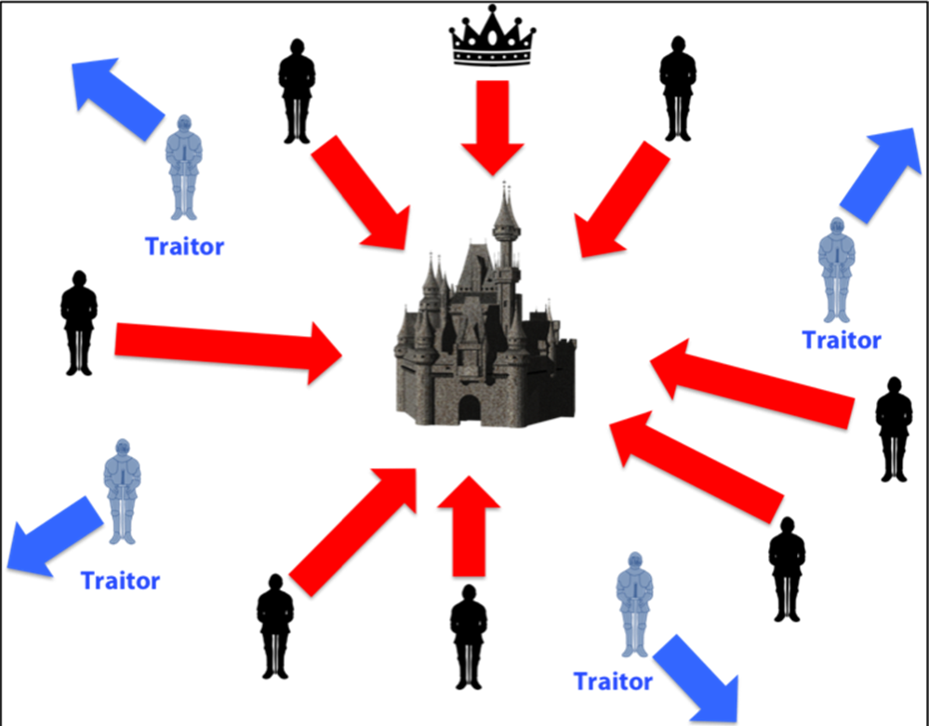
PBFT (Practical Byzantine Fault Tolerance)
PBFT as blockchain consensus algorithm
Nodes collecting transactions, select a leader for the next block
Can be random (deterministic) or random based on a stake
The leader orders the transactions + broadcasts the ordered list
Each node validates / executes the transactions + broadcasts the calculated hash of the new block
When 2/3 of the nodes have the same hash
The new block is published (mined)
Transactions are very fast

Slide 24




PBFT Variations and Cryptocurrencies
Hyperledger Fabric
https://hyperledger.org/projects/fabric
NEO – neo.org
Delegated Byzantine Fault Tolerance (dBFT)
Ripple (XRP) – ripple.com/xrp
Ripple Consensus Algorithm
Stellar – stellar.org
Federated Byzantine Agreement (FBA)

Slide 25

Proof of Authority (PoA)
Proof-of-Authority (PoA) assigns a set of trusted nodes (authorities) to process transactions and build new blocks
News blocks need to be signed by the majority of authorities
Works very well in private blockchains (cross validation)
Great performance, fast transactions, high throughput
Examples:
POA Network – https://poa.network
Ethereum Rinkeby Testnet – https://www.rinkeby.io

Slide 26

Proof of Elapsed Time (PoET)
PoET relies on a trusted execution environment (TEE)
Supported by modern CPUs from Intel, AMD and ARM
No cryptographic puzzle (like in PoW algorithms)
PoET ensures blocks get produced in a random lottery fashion
Generates securely the next block + a proof of the waiting time inside the TEE
The proof of waiting time can be verified by all other nodes
Problem: a small subset of compromised nodes can compromise the entire system

Slide 27
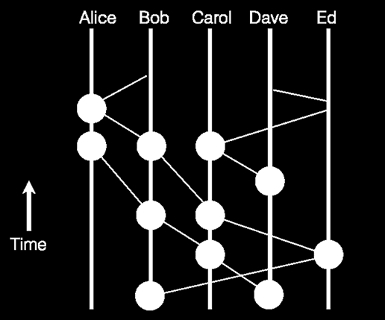
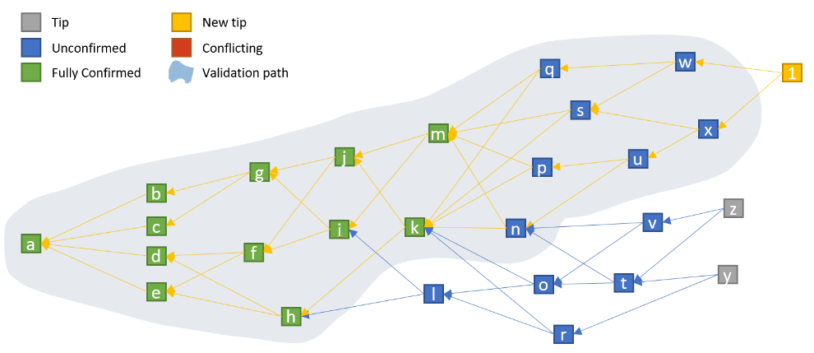
Non-Blockchain DLT
Distributed Ledger Technologies (DLT) without a Blockchain

Slide 28
DAG / Tangle / IOTA
Tangle == blockless distributed ledger
Based on DAG (directed acyclic graph)
Used by IOTA – iota.org
Transactions with zero fees
Validate 2 transactions to get your transaction validated for free
Store data from sensors and dataloggers securely and verified
Scalable – more nodes add more processing power
Lightweight – validators don't need the entire blockchain

Slide 29
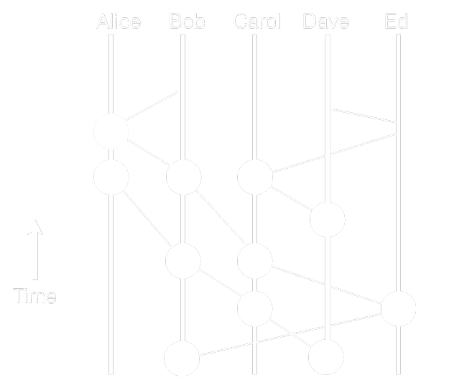
HashGraph
Superior distributed ledger technology system
https://hashgraph.com
Fast: with a very high throughput and low consensus latency
Secure: asynchronous byzantine fault tolerant
Fair: fairness of access, ordering, and timestamps

Slide 30

Exercise: Explore Cryptocurrencies
https://coinmarketcap.com

Slide 31

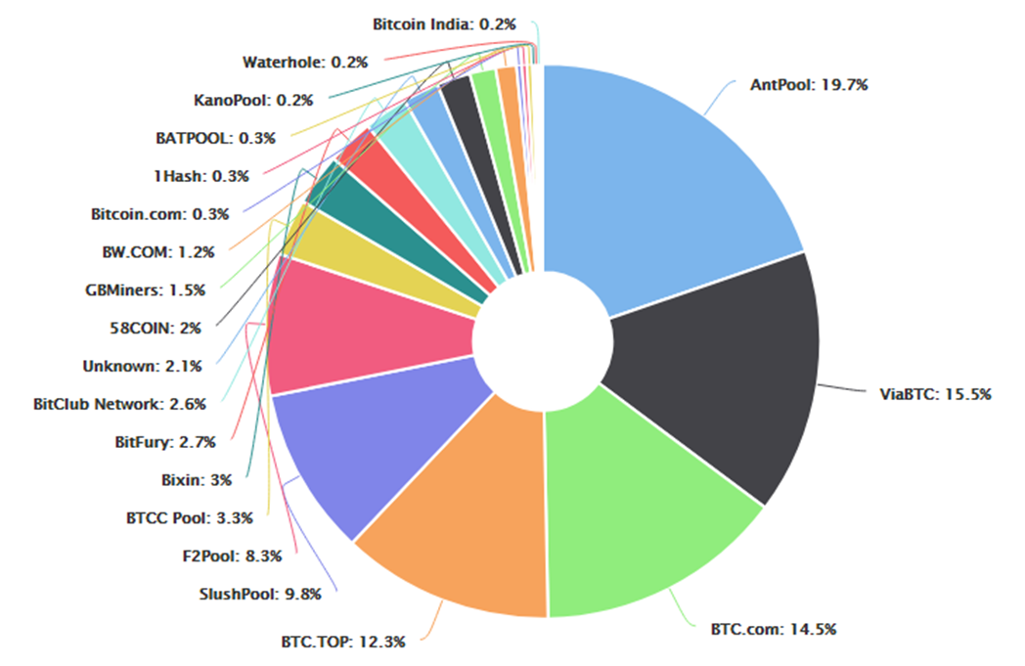
Bitcoin
Bitcoin
bitcoin.org
Consensus algorithm
Proof of work (PoW)
Hash function
SHA256
Mining
ASIC mineable

Slide 32

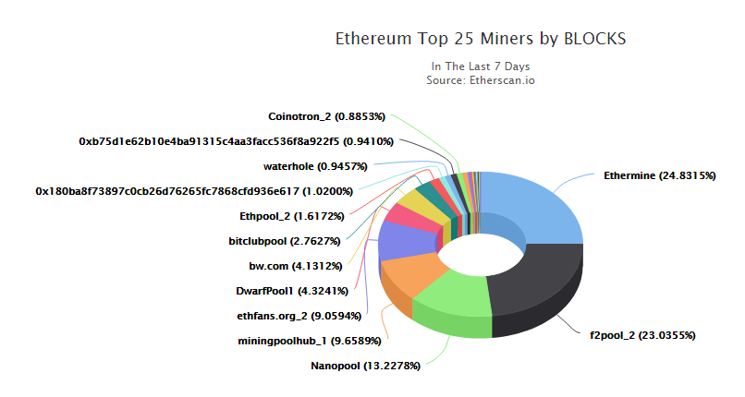
Ethereum
Ethereum
ethereum.org
Consensus algorithm
Proof of work (PoW)
Hash function
ETHash
Mining
GPU and ASIC mineable

Slide 33

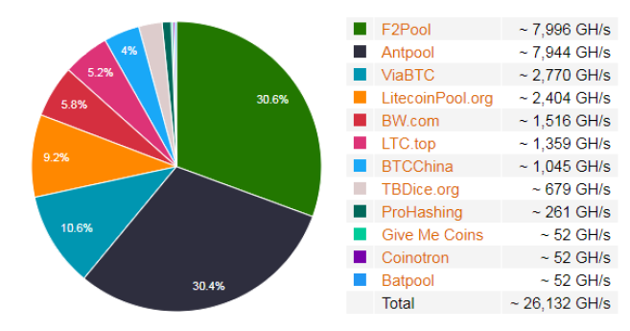
Litecoin
Litecoin
litecoin.org
Consensus algorithm
Proof of work (PoW)
Hash function
SCrypt (‘ess crypt’)
Mining
GPU and ASIC mineable

Slide 34

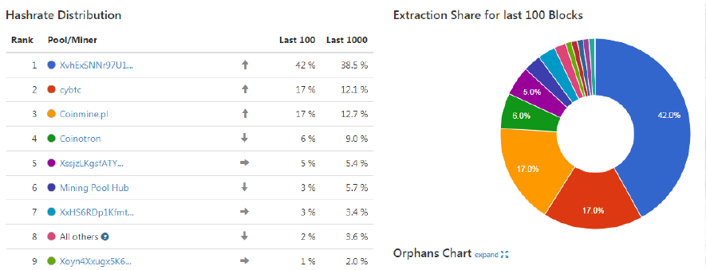
Dash
Dash
dash.org
Consensus algorithm
Proof of work (PoW)
Hash function
X11
Mining
GPU and ASIC mineable

Slide 35

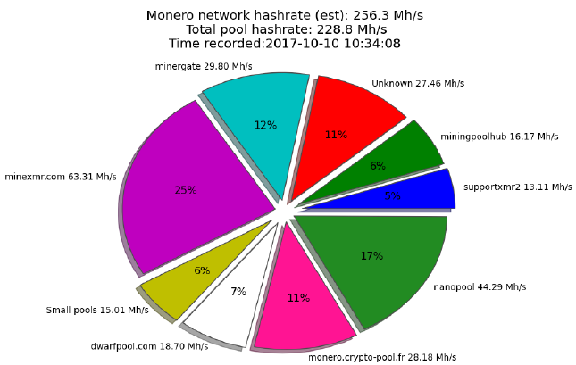
Monero
Monero – getmonero.org
Anonymous blockchain
Consensus algorithm
Proof of work (PoW)
Hash function
CryptoNight
Mining
CPU and GPU mineable

Slide 36

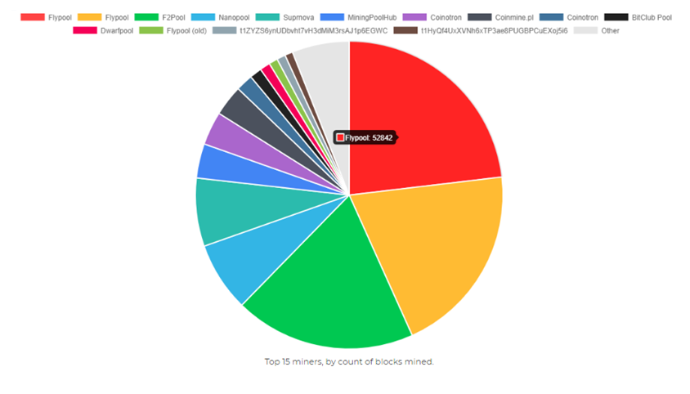
ZCash
ZCash – z.cash
Highly anonymous transactions
Consensus algorithm
Proof of work (PoW)
Hash function
Equihash
Mining
CPU and GPU mineable

Slide 37
Ripple
Ripple – ripple.com/xrp
Private blockchain for banks and financial institutions
Semi-decentralized (the only trusted nodes in the network are owned by Ripple Labs)
Consensus algorithm
Ripple consensus (federated PBFT variation)
Mining
Not mineable (only one company sells all XRP)
Each transaction burns a small fee → no profit for validators

Slide 38

Cardano
Cardano – cardanohub.org
Decentralized public blockchain and cryptocurrency
Smart contract platform
Consensus algorithm
Proof of Stake (PoS) – cardanodocs.com/cardano/proof-of-stake
Mining
Slot leaders are selected randomly according their stake
Slot leaders mine the next blocks → collect transaction fees

Slide 39

IOTA
IOTA – https://iota.org
Public blockless distributed ledger (not a blockchain), no fees
Consensus algorithm
Directed Acyclic Graph DAG (Tangle) – goo.gl/ehrfEu
The transaction issuers are also transaction approvers
Mining
No mining → all IOTA are pre-mined (in the genesis block)
No transaction fees – pay by verifying at least 2 other transactions

Slide 40

NEM
NEM – nem.io
Public blockchain & cryptocurrency
Consensus algorithm
Proof of Importance (PoI)
Mining
No mining, stakeholders can harvest blocks for transaction fees
Harvesting in proportional to coins held and transactions performed

Slide 41
Stellar
Stellar – stellar.org
Aims to let you transact in your currency of choice (fiat or digital)
Send money worldwide / exchange at low cost in any currency
Uses lumens (XLM) as cryptocurrency coins
Consensus algorithm
Federated Byzantine Agreement (FBA), 3-5 seconds / transaction
Mining
No mining, all lumens are already distributed

Slide 42
EOS
EOS – eos.io
Powerful infrastructure for decentralized applications (DApps)
Asynchronous smart contracts + database + account permissions + internet communications (like OS on the blockchain)
Designed for millions transactions per second
Consensus algorithm
Delegated Proof of Stake (DPOS)
Mining
No mining, all EOS tokens are sold in a massive crowdsale (ICO)

Slide 43

Exercise
Explore and Compare Cryptocurrencies

Slide 44

Blockchain Network Forks
Hard Fork and Soft Fork

Slide 45
Hard Fork
Hard fork == radical change to the protocol
Makes previously valid blocks / transactions invalid (or vice-versa)
Nodes running previous versions are no longer be accepted
Hard forks produce two blockchain networks running in parallel
One path follows the new blockchain (e.g. Bitcoin Gold)
Other path continues along the old blockchain (e.g. Bitcoin)
Requires all nodes to upgrade and agree on the new version
Not backward-compatible (unidirectional)

Slide 46
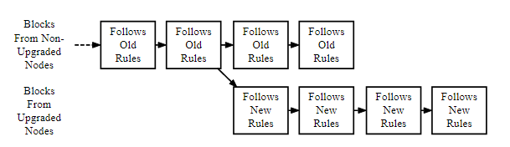
Why Hard Fork is Needed?
Correct important security risks found in older versions of the software (including proven fraud, like the DAO hack)
Add new functionality (incompatible with the old versions)
Reverse transactions (after heavy community debate)

Slide 47
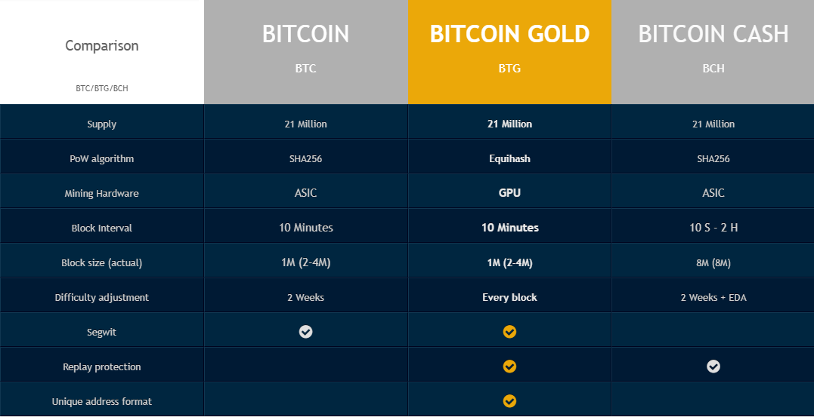
Bitcoin Hard Forks
SegWit2x – cancelled

Slide 48

Ethereum Hard Forks
The DAO Hack
Bug in a smart contract "TheDAO" code caused a hacker to steal 3.6 millions ETH
The Ethereum platform has been hard-forked into:
Ethereum Classic (old) → the blockchain should stay immutable forever (code is law)
Ethereum (new) → ethically wrong / fraudulent transactions can be reverted by community voting

Slide 49
Soft Fork
Soft fork == change to the blockchain software protocol
Such that updated versions are backwards compatible
The old software will recognize any new blocks
No fork of the blockchain, no change in transactions and blocks
Requires only a majority of the nodes to upgrade
Old nodes will still accept blocks created by new nodes
Not following the new consensus rules
Soft form example: BIP66 → change in the signatures format

Slide 50
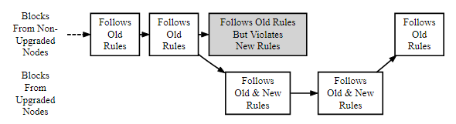
Why Soft Fork is Needed ?
To implement new and upgraded functionalities that are backwards compatible

Slide 51

Summary
Consensus algorithm – mechanism to reach agreement among the blockchain nodes about the changes in the distributed ledger
Proof-of-work (PoW), Proof-of-stake (PoS), Delegated PoS (DPoS), Leased PoS (LPoS), Proof-of-authority (PoA), BPFT, PoB, PoI, others
Non-blockchain distributed ledger technologies (DLT)
HashGraph and Tangle
Hard fork – incompatible protocol change (could change consensus algorithm, protocol rules, revert transactions, etc.)
Soft Fork – backwards compatible protocol update

Slide 52
Decentralization and Consensus Protocols
http://www.kingsland.academy

Slide 53
Resources
Decentralization: https://medium.com/@VitalikButerin/the-meaning-of-decentralization-a0c92b76a274
Proof of ..: https://www.coindesk.com/short-guide-blockchain-consensus-protocols/
Leased Proof of Stake: https://www.cryptocompare.com/mining/guides/how-to-mine-waves/
Delegated Proof of Stake: https://captainaltcoin.com/delegated-proof-stake/
Hard Fork: https://www.investopedia.com/terms/h/hard-fork.asp
Soft Fork: https://www.investopedia.com/terms/s/soft-fork.asp

Slide 54
Resources (2)
Ethereum Classic: https://en.wikipedia.org/wiki/Ethereum_Classic
51 % Attack: https://www.investopedia.com/terms/1/51-attack.asp
HashGraph: https://medium.com/@justindanneman/blockchain-just-became-obsolete-the-future-is-hashgraph-de4948609cbf
Tangle: https://iota.org/

